Slide 1
GitHub
Pull Requests

Slide 2
In the previous steps, you had made a Clone repository from the master, add/edit files or folders in client machine. Now, you wanna check in to GitGub…

Slide 3
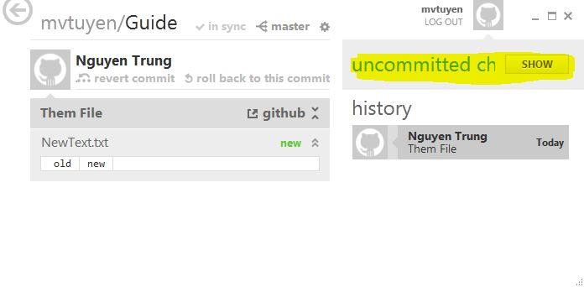
When you edit your repository in client machine, GitHub show the “uncommitted changes” (yellow light).
Click “Show” button.

Slide 4
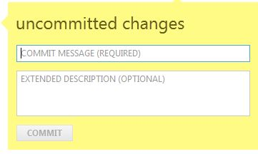
Fill two text box above (Commit message is required).
Click “Commit” to next step.

Slide 5
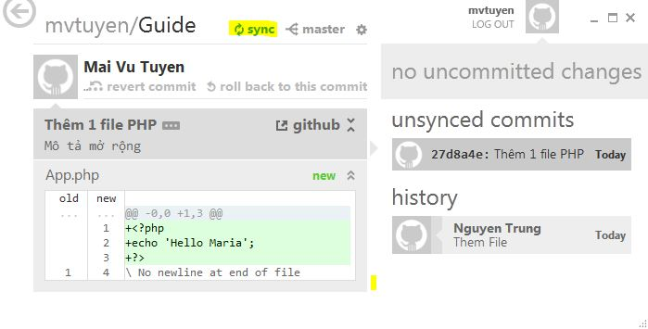
Click “Sync” (Yellow light) to check in to GitHub.
And now you return to your browser, refresh your browser or enter to the repository of your in GitHub.

Slide 6
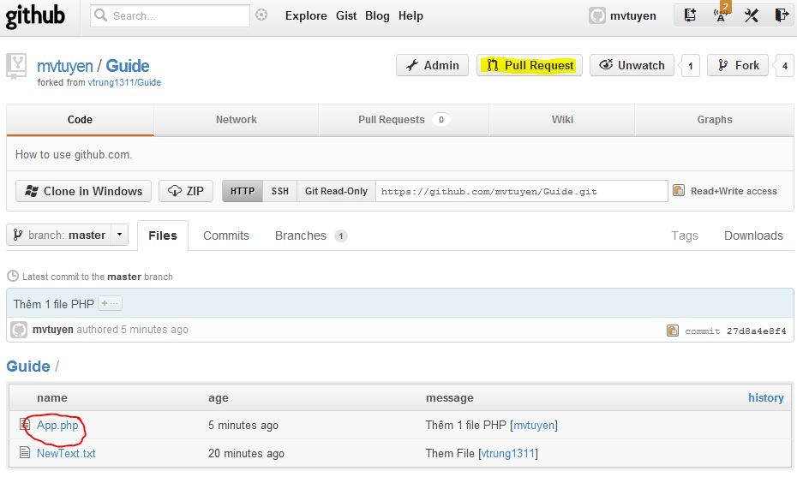
In this page, the red cycle is a file which you just add.
If you wana send the repository to Master, click the “Pull Request” button (Yellow light).

Slide 7
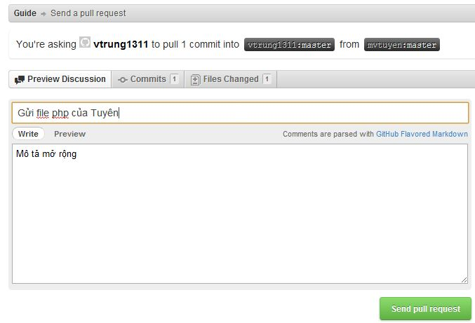
Now, you fill the textboxs and click “Send pull request” button.
After that, your repository has been sent to Master.

Slide 8
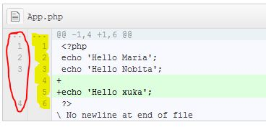
In the Diff tab, the system show the list difference.
The red cycle is the old code lines.
The yellow light is the new code lines.

